Slide 1
Southern California Edison LiDAR
August
8, 2023
Carissa Suarsana
Wilson Lu

Slide 2

Background on the Issue
Senate Bill 901 (SB-901) passed in 2018, which required utility companies to have wildfire-mitigation plans, including regular inspections for all power assets.
These assets usually take many hours to manage and not easily accessible due to their locations.
Dispatching teams of people to assess the status of power equipment is expensive and time consuming.

Slide 3
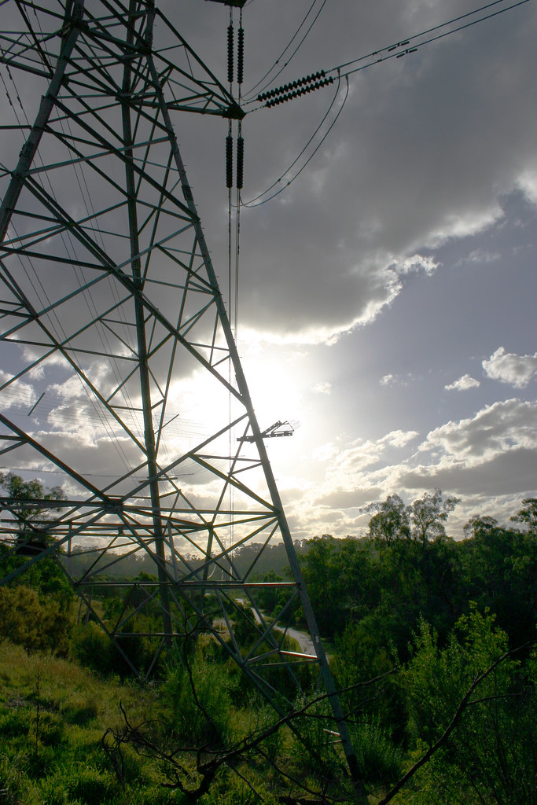
Objective
Research Question: Can SCE perform its own point-cloud analysis using deep-learning tools, image analytics, and other geoprocessing tools provided by ArcGIS instead of relying on 3rd party vendors?
Demonstrate the capability of a LiDAR point cloud data-processing tool.
Determine if deep learning is an effective solution for extracting desired objects from LiDAR data.
This Photo by Unknown Author is licensed under CC BY

Slide 4
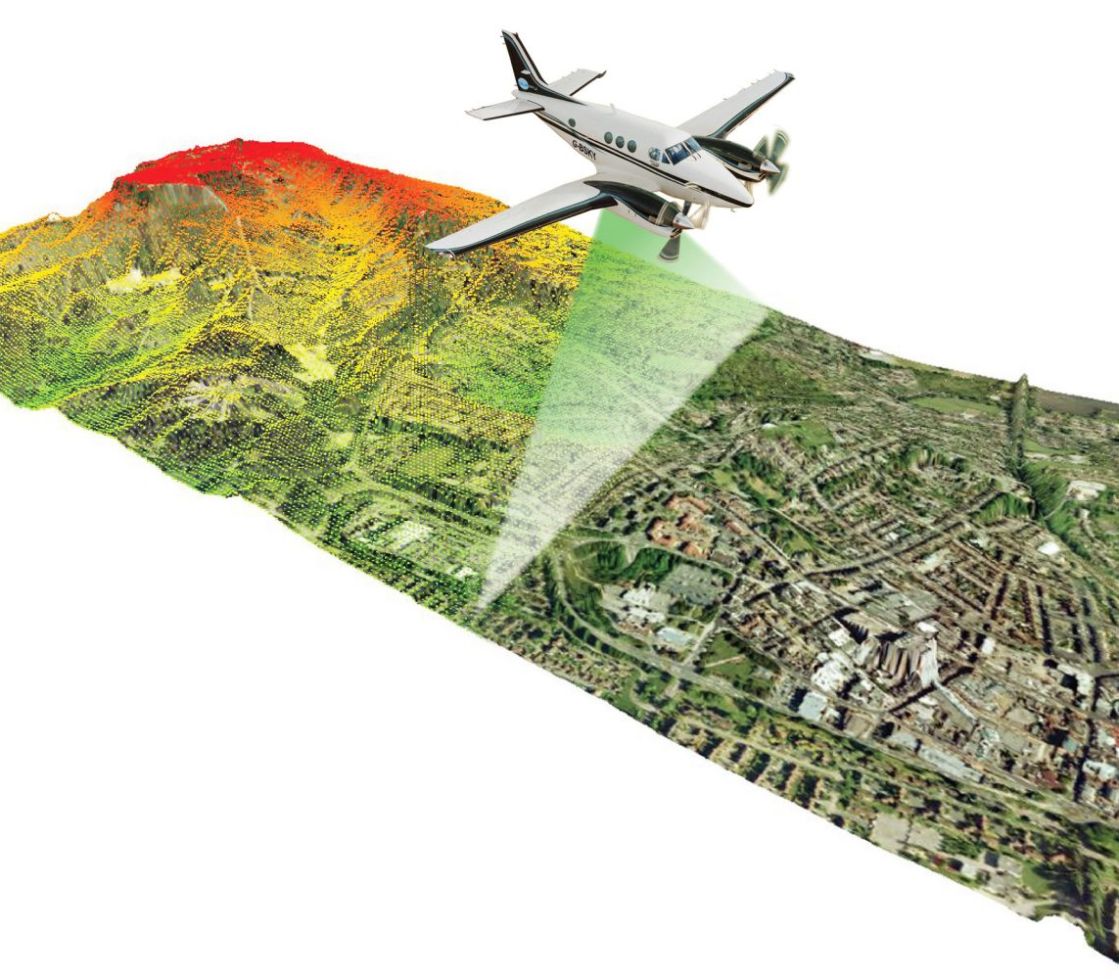
Introduction to LiDAR
Light Detection and Ranging
Remote-sensing technique that uses laser light to sample the surface of the earth,
Produces x, y, z measurements and point cloud datasets that can be managed, visualized, analyzed, and shared.
This Photo by Unknown Author is licensed under CC BY-SA-NC

Slide 5


Tools & Resources
ArcGIS Pro 3.1.2
ESRI, Learn ArcGIS
This Photo by Unknown Author is licensed under CC BY-NC-ND

Slide 6
Findings
The classification model ran flawlessly on the training data and was able to display all 4 types of classification codes we assigned to it.
The deep learning model was able to identify and classify high vegetation and transmission wires in most, if not all, the LAS datasets we had.
However, it struggled to classify transmission poles correctly and was only able to classify half a transmission tower.
Not correct classification code.

Slide 7
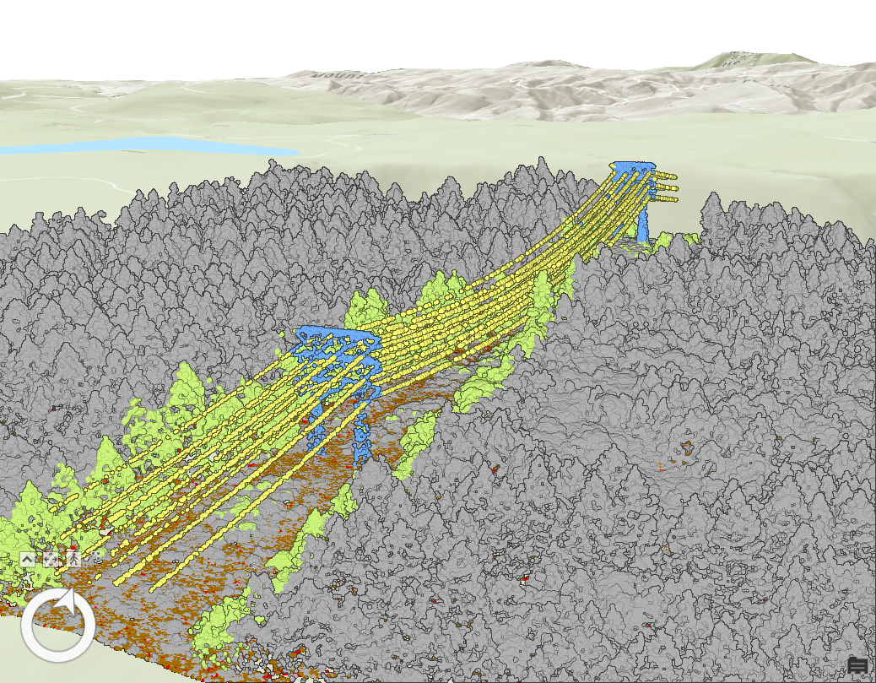
Images of Final Results
Training Data After Classification Model

Slide 8
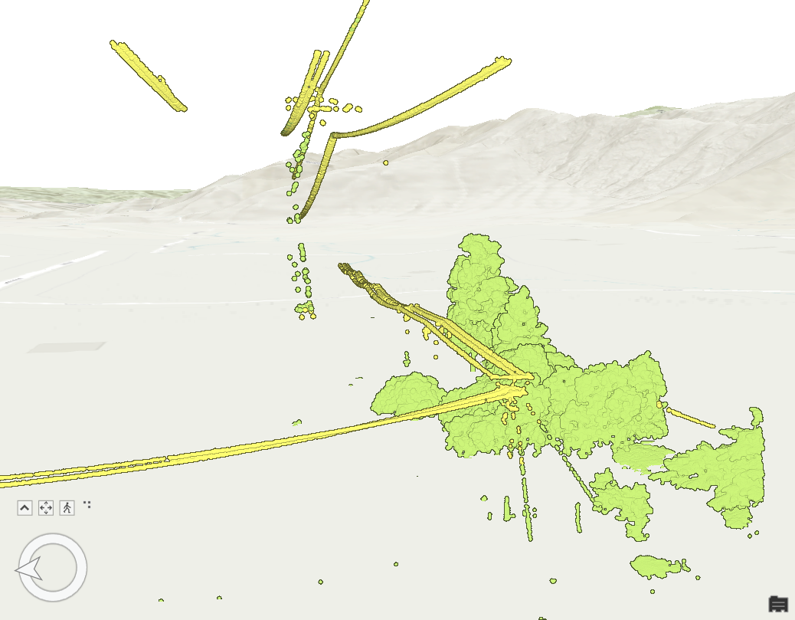
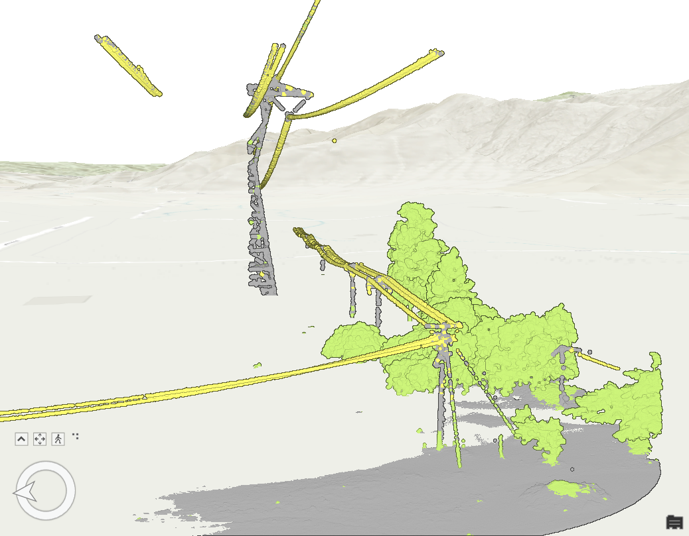
Results of Classification Model
LASD Before Classification Model
LASD After Classification Model

Slide 9
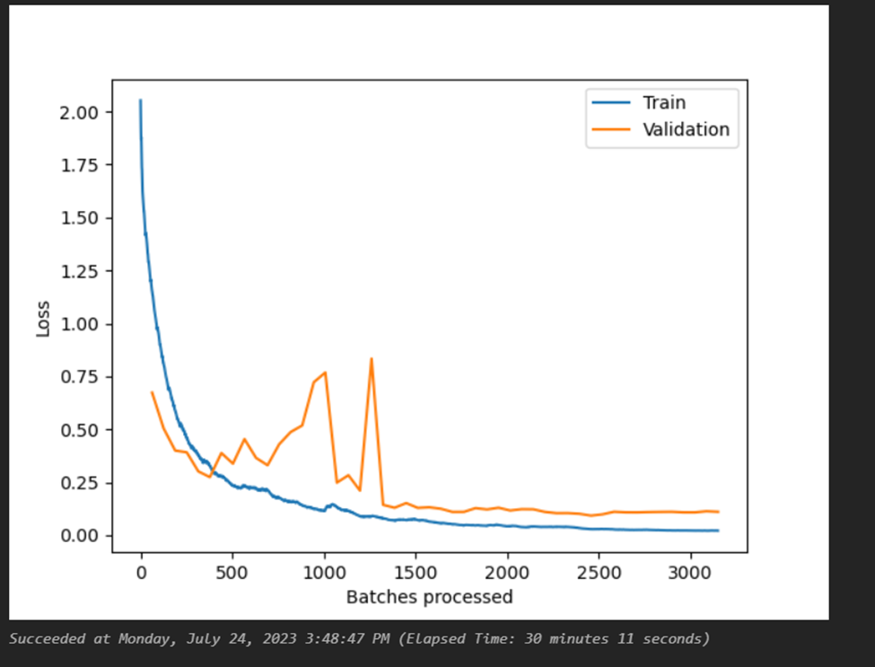
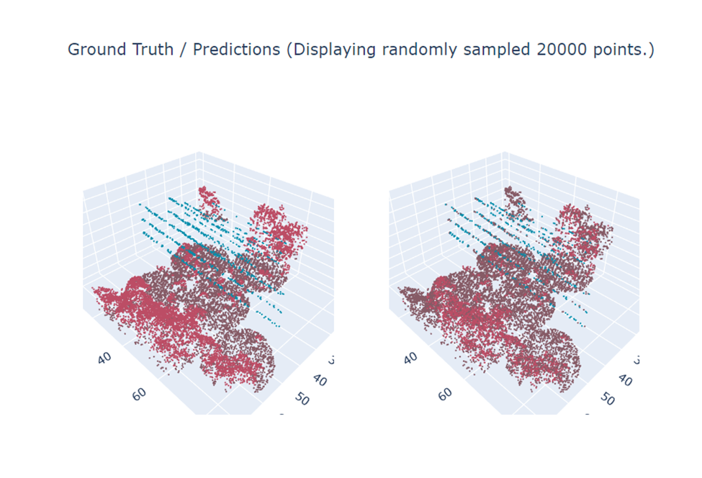
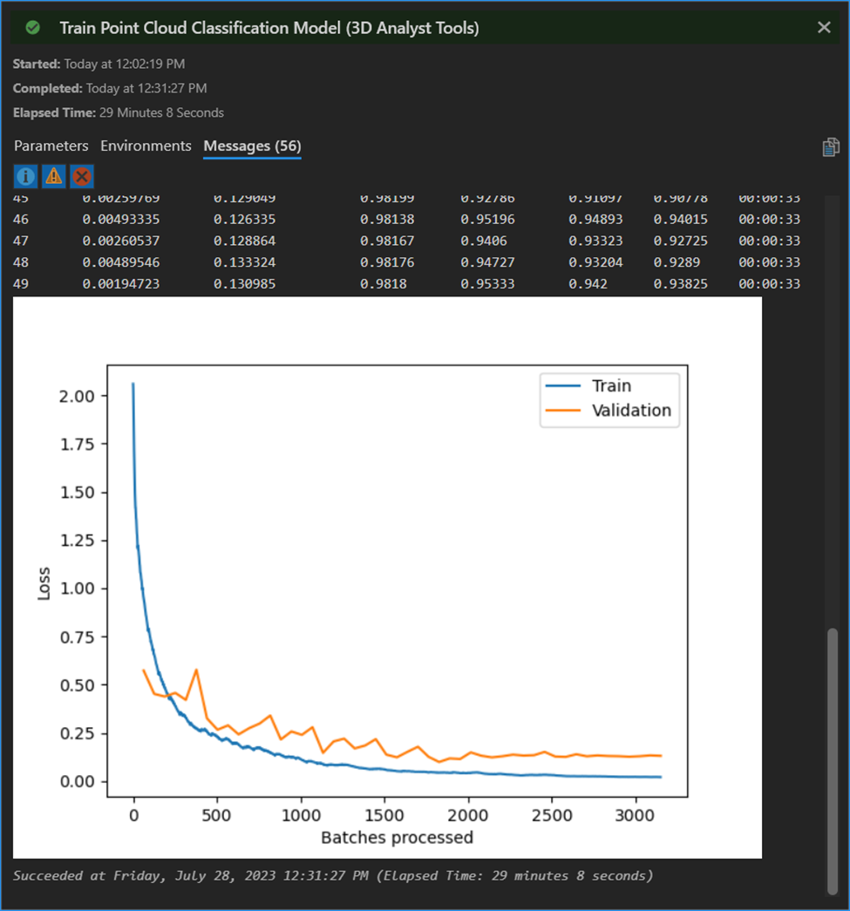
Results of Classification Model

Slide 10
Workflow
Prepare Training Data
Train Classification Model
Convert LAZ to LAS/LASD
Classify LAS Dataset with Model
Start
End

Slide 11
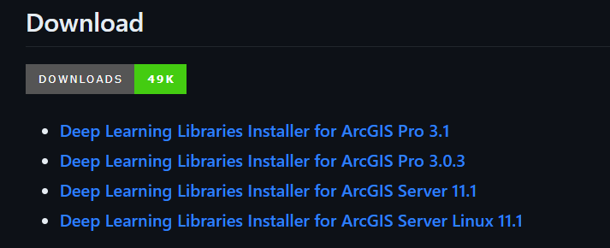
Install Deep Learning Frameworks
Deep learning geoprocessing tools in ArcGIS Pro require supported deep learning frameworks libraries installed.
https://github.com/Esri/deep-learning-frameworks/blob/master/README.md?rmedium=links_esri_com_b_d&rsource=https%3A%2F%2Flinks.esri.com%2Fdeep-learning-framework-install

Slide 12
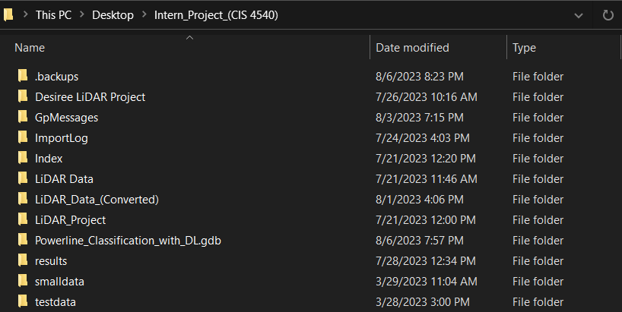
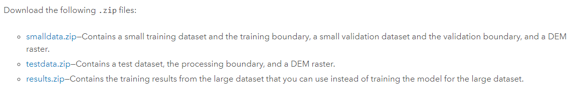
Download Training Data
Step 1: Navigate to the Classify power lines using deep learning tutorial, available @ https://learn.arcgis.com/en/projects/classify-powerlines-from-lidar-point-clouds/
Step 2: Scroll down to the "Download the Data" section and download the .zip files (smalldata, testdata, results).
Step 3: Extract the files into a folder that you can easily find/access (preferably the same folder you created your project in).

Slide 13
Point-Cloud Datasets
Point-cloud datasets | File size | LAS Points
SCE LiDAR data | 7.83 GB | 233,571,578
test (Training Data) | 38 MB | 3,253,697
val_small (Training Data) | 38 MB | 1,233,135
train_small (Training Data) | 106 MB | 4,042,521

Slide 14
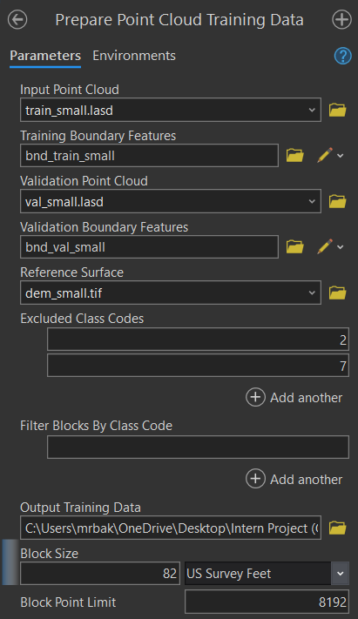
Prepare Training Data
Step 1: Enter parameters for Input Point Cloud, Training Boundary Features, Validation Point Cloud, Validation Boundary Features, and Reference Surface by following the ESRI guide.
Step 2: Exclude Class Codes 2 (ground) and 7 (noise); this will allow the model to run faster.
Step 3: For Output Training Data, click Browse and browse to <location of your results folder>. For Name, type training_data_small.pctd.
Step 4: Enter 82 for Block Size. For Unknown, click the drop-down menu and choose US Survey Feet. For Block Point Limit, keep the default of 8192.

Slide 15
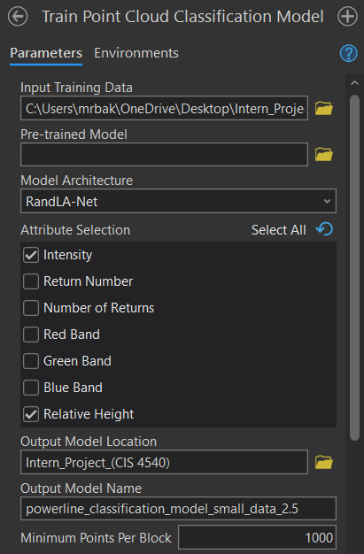
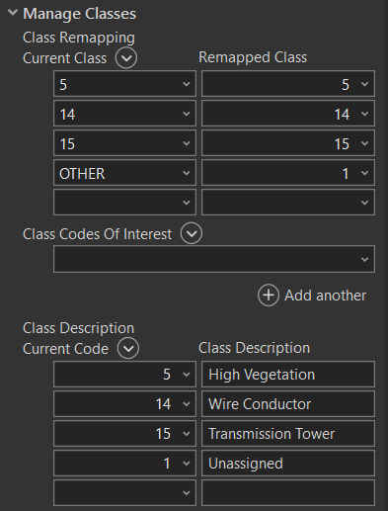
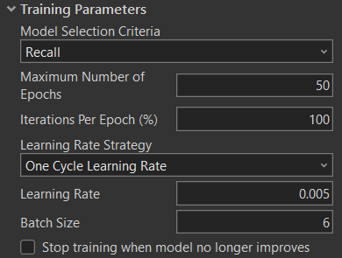
Training the Model
Step 1: For Input Training Data, click Browse, browse to results folder and select training_data_small.pctd.
Step 2: Check Intensity and Relative Height for Attribute Selection.
Step 3: Select folder for Output Model Location and name the output model.
Step 4: Enter parameters for Min. Points Per Block.
Step 5: Add classes 5, 14, and 15 for Current Class. Reassign all OTHER class codes to 1.
Step 6: Change Max. Number of Epochs to 50.
Step 7: Change Learning Rate to 0.006. Leave Batch Size at the default value 6 and uncheck "Stop training when model no longer improves".

Slide 16
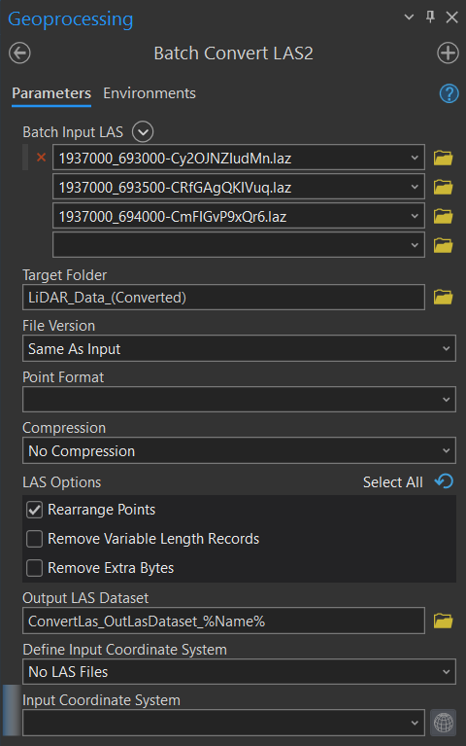
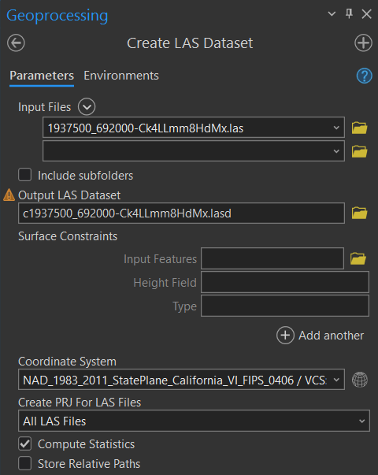
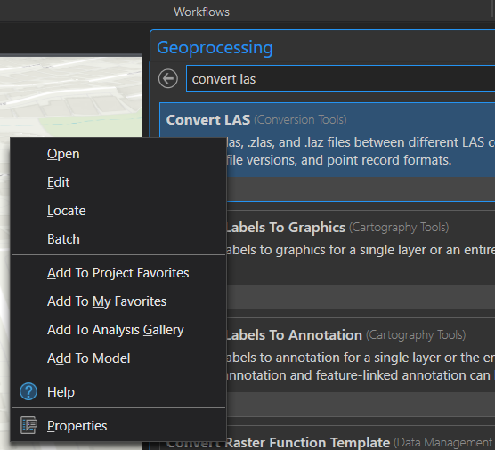
Convert LAZ to LAS/LASD
Batch Conversion LAZ LAS
Convert LAS LASD

Slide 17
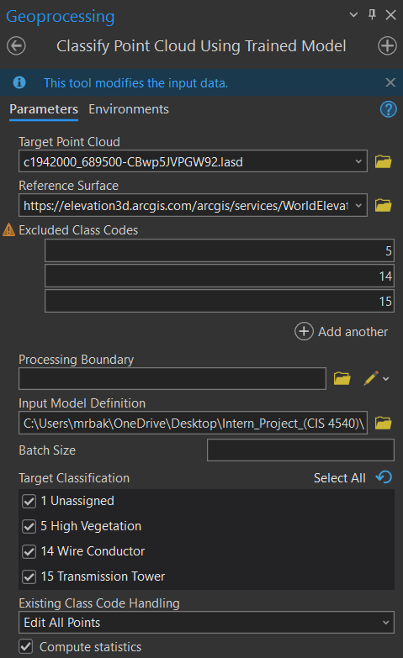
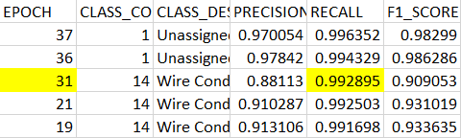
Classify LAS Dataset Using Trained Model
Step 1: Enter parameters for Target Point Cloud and Reference Surface.
Step 2: Exclude classes 5, 14, and 15.
Step 3: For Input Model Definition, click Browse and browse to <folder you saved your classification model results to> choose the epoch with the highest recall percentage for Class code 14 (Transmission Wire) and ensure all 4 classes are selected for Target Classification.

Slide 18
Discussion of Findings and Next Steps
Batch conversion.
Extensive time based on computing system.
Different epoch numbers.
Use results from smalldata folder instead of large data to achieve a more accurate classification model.
One of the datasets appeared in the middle of the ocean after we double checked the coordinate system.
Next Steps
Train the model.
Develop more accurately labeled data that closely represents the objects of interest.

Slide 19
References
https://learn.arcgis.com/en/projects/classify-powerlines-from-lidar-point-clouds/
https://pro.arcgis.com/en/pro-app/latest/help/analysis/deep-learning/install-deep-learning-frameworks.htm
https://pro.arcgis.com/en/pro-app/latest/help/data/las-dataset/what-is-lidar-.htm#:~:text=Lidar%20(light%20detection%20and%20ranging,x%2Cy%2Cz%20measurements

Slide 20
THANK YOU!
Questions?
csuarsa@calstatela.edu
wlu3@calstatela.edu

